Slide 1
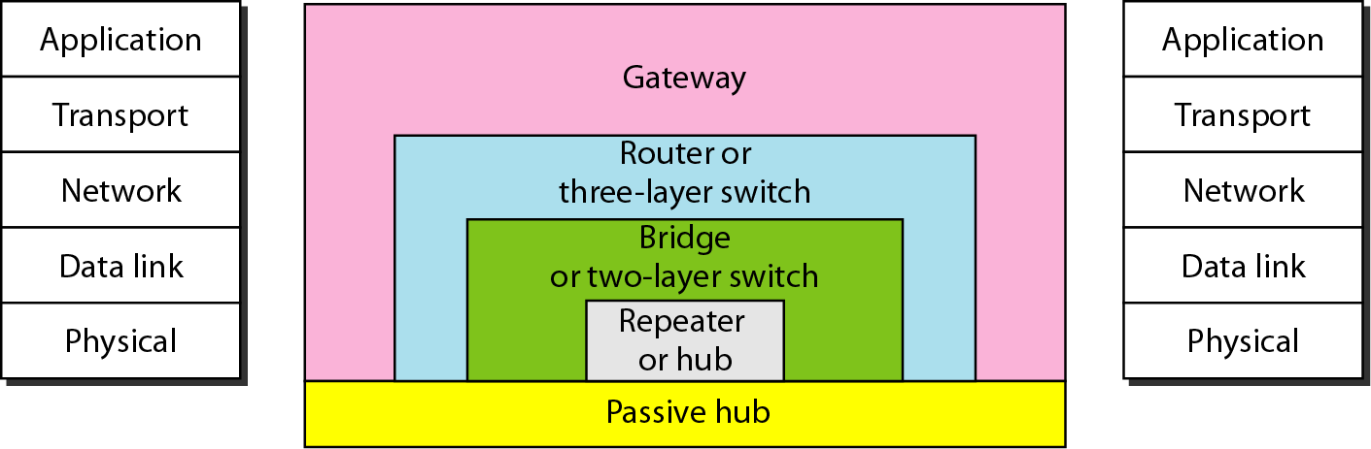
Network Hardware Components

Slide 2
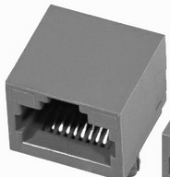
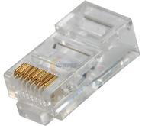
Connectors
Generally, the connectors are male-female type.
Connector for Twisted Pair Cable:
Connect to networking devices such as network interface cards and switches using RJ45 (Registered Jack) connectors.
One end must connect to a host, the other to a networking device such as a switch. You can only connect two computers together if you use a crossover cable, which uses different wiring.
Consists of four pairs of copper wires twisted around each other. Twists are used
because they reduce interference.
Maximum length: 100 meters (328 feet).
Maximum bandwidth: 1000 Mbps.

Slide 3
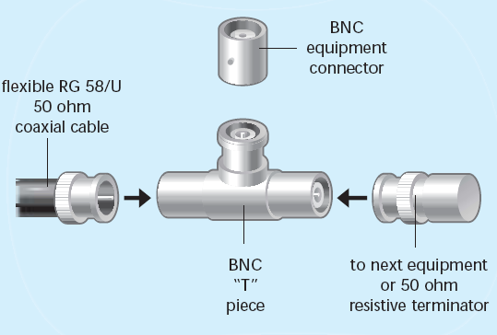
Connector for Coaxial Cable:
Hosts on an RG58 network require a network card with an RG58 adapter.
To add the host to the network, the cable section must have an RG58 connector on
both ends with a “T” piece fitted between them.
Both ends of the segment should be terminated using a piece of equipment known as a terminator.
A terminator stops signals on the network echoing back when they reach the end of
the segment.
Maximum bandwidth of 10 Mbps.
Maximum segment length of 185 Meters (605 feet).
Maximum of 30 hosts per segment.

Slide 4
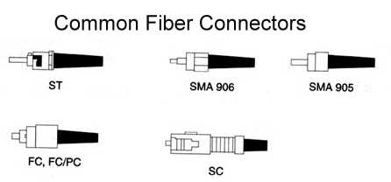
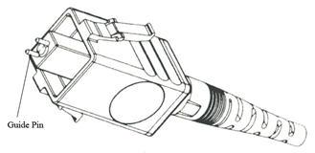
Connector for Fiber optic cable:
There are many types of fiber optic cable connectors:
ST Connectors: Slotted bayonet type connector with long ferrule. Common
connector for multimode fibers.
FC Connectors: Screw on type connector. Popular with single mode fibers.
SC Connectors: Push/pull connector that can also be used with duplex fiber
construction.
LC Connectors: Much like the ST connector but with a ferrule that is half the size.
MT-RJ Connectors: Connector configured for duplex fibers with both fibers in one
ferrule.
MU Connectors: Much like the SC connector but with a ferrule about half the size.
MT-RJ
MT-RJ

Slide 5
Network Interface Card (NIC)
Network Interface Card (NIC). Also known as Network Card or Ethernet Adapter. Transmits and receives signals to the LAN. Computers can not communicate on LAN without this device.
Each Network Card has a Media Access Control (MAC) address. This is also known as the physical address or Ethernet address.
MAC address is a unique 12 digit hexadecimal number that is hard coded into each network interface. The first half of a MAC address is the manufacturer’s ID. The second half a serial number.
00-04-AC
Manufacturer ID
-F3-1C-D4
Serial number

Slide 6
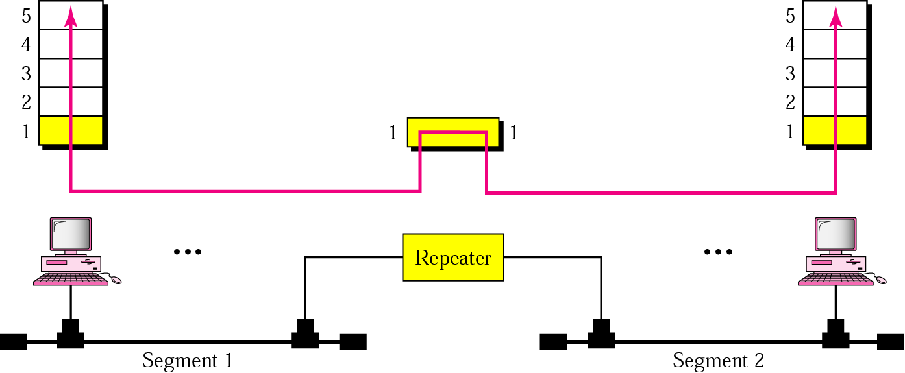
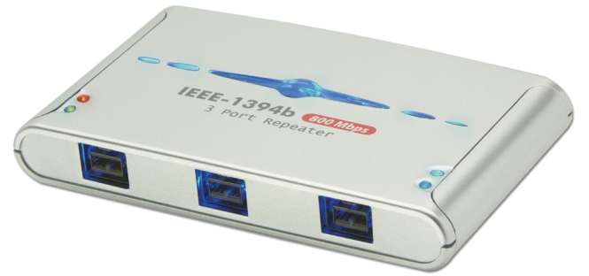
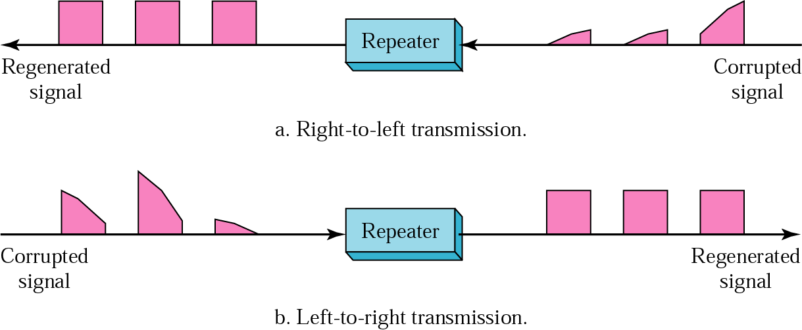
Repeaters
A repeater connects two segments of a LAN.
A repeater forwards every frame; it has no filtering capability.
A repeater is a regenerator, not an amplifier.
Function of a repeater

Slide 7
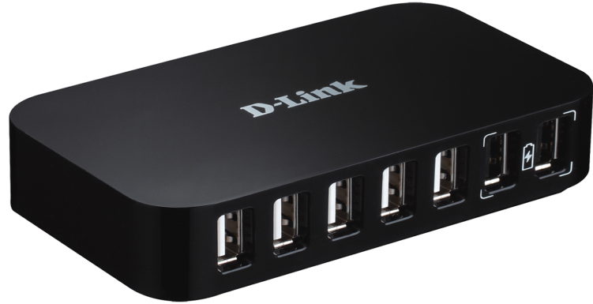
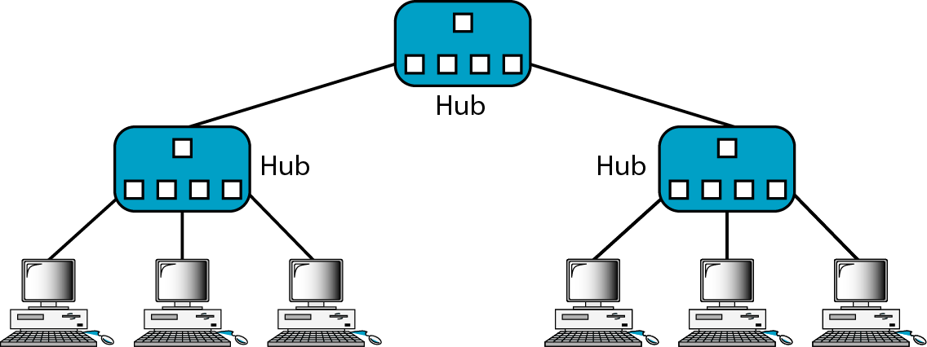
Hub
As an active hubs regenerate signals, it increases the distance that can be spanned by the LAN (up to 100 meters per segment).
Hubs can also be connected locally to a maximum of two other hubs, thereby increasing the number of devices that can be attached to the LAN.
Active hubs are usually used for regeneration and amplification of signals.
Intelligent hub perform some network management and intelligent path selection.
Disadvantages
Bandwidth is shared by all hosts i.e. 10Mbs shared by 25 ports/users.
Can create bottlenecks when used with switches.
Have no layer 3 switching capability.

Slide 8
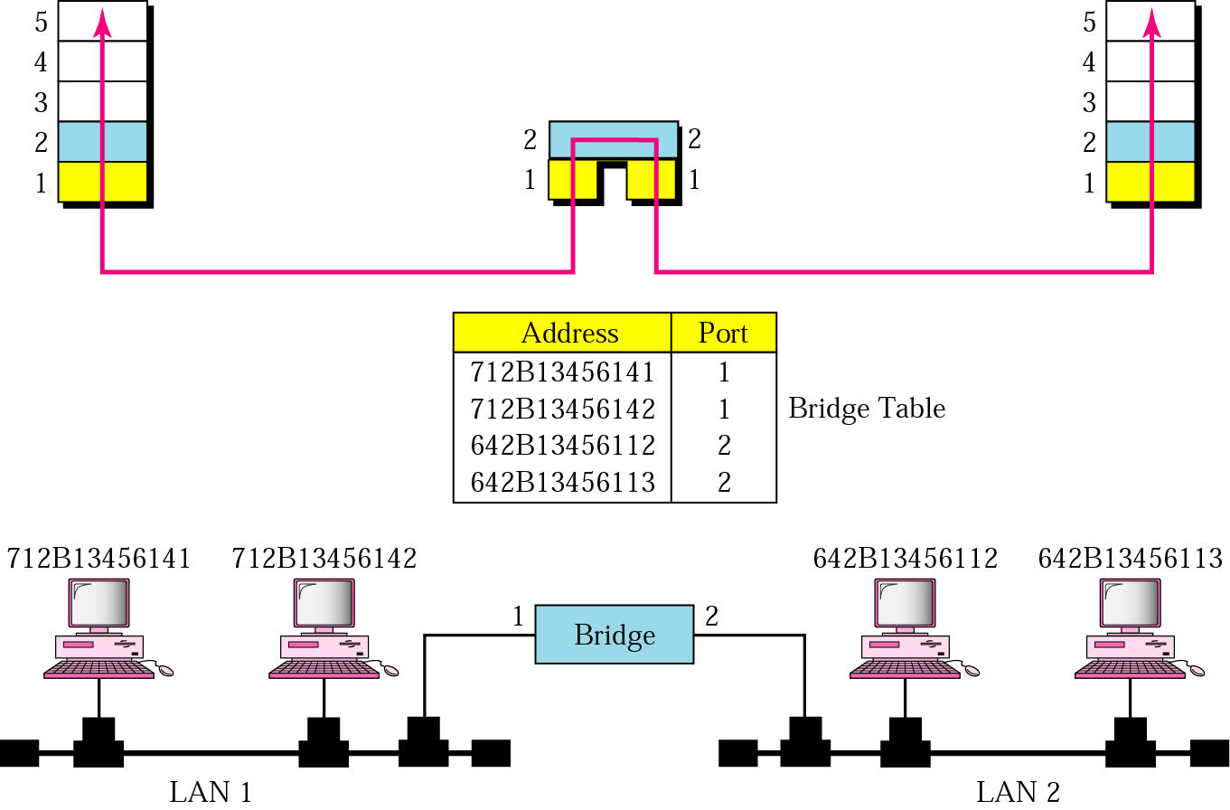
Bridge
Frame filtering and forwarding . A bridge has a table that maps addresses to ports.
Learning the address
Routing

Slide 9
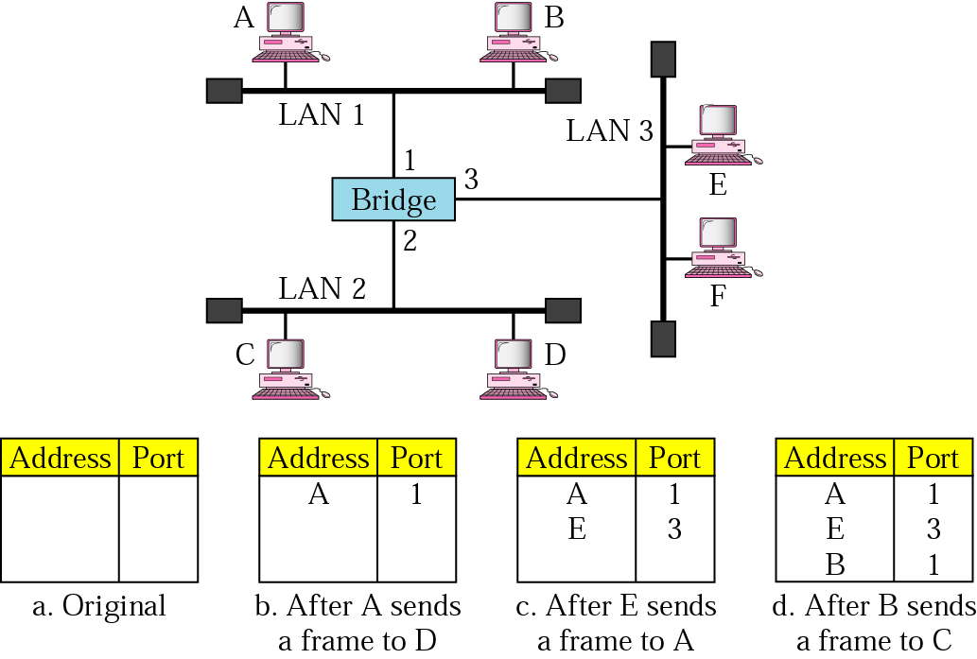

Slide 10
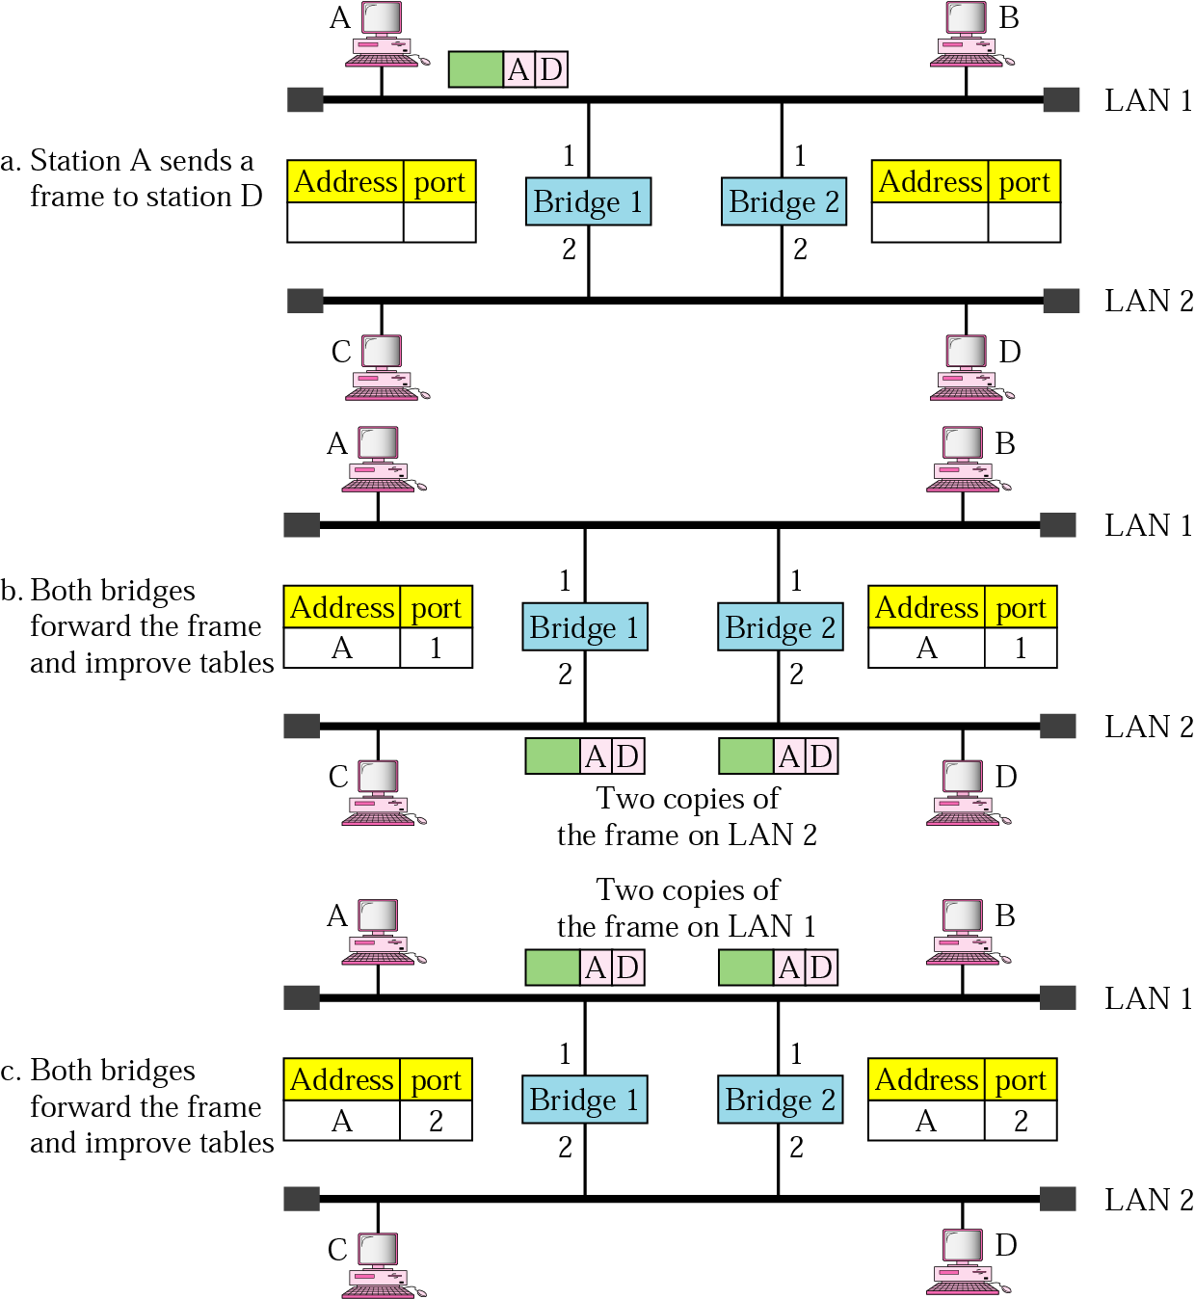

Slide 11
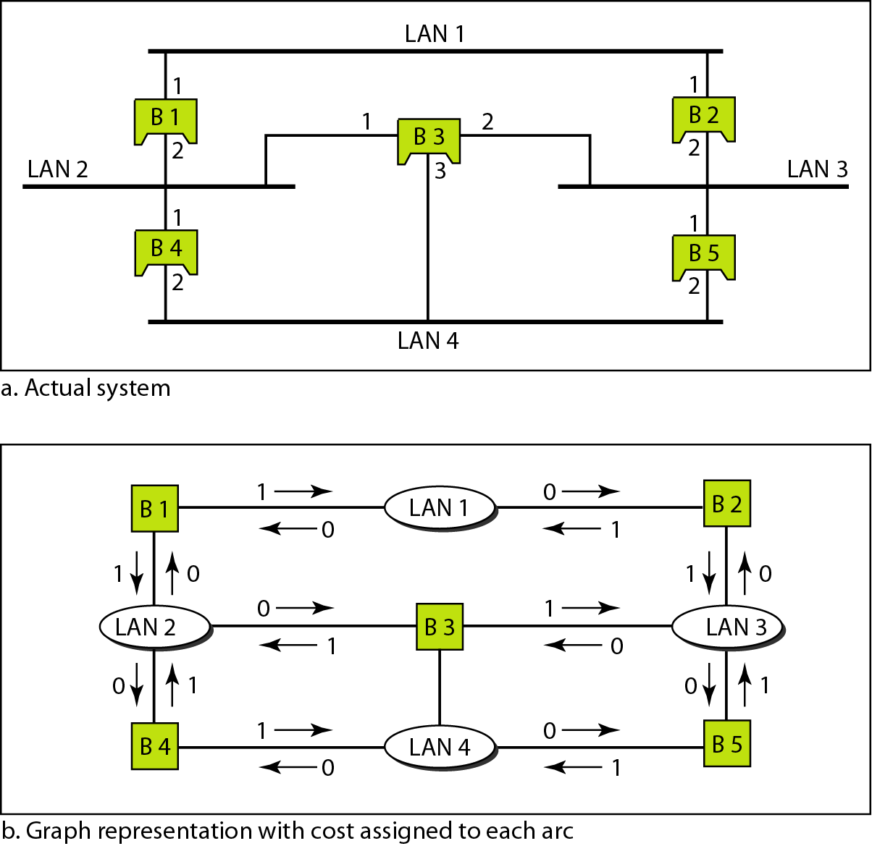
What happens if you have a loop of bridges/switches in your LAN?

Slide 12
Applying spanning tree
Step 1: Every bridge has an ID. Select the bridge with smallest ID. This is the root bridge.
Step 2: Mark one port of each bridge (except root bridge) as the root port. Root port is the port with least-cost path from the bridge to the root bridge (marked with 1 star).
Step 3: For each LAN, choose a designated bridge. A designated bridge has the least-cost path between the LAN and root bridge (the arrows). Mark the corresponding port that connects the LAN to its designated bridge the designated port (two stars).
Step 4: Mark the root port and designated port as forwarding ports, the others as blocking ports (every port with 1 or 2 stars keep, ports with no stars drop).
Note - there is only 1 path between any two bridges.

Slide 13
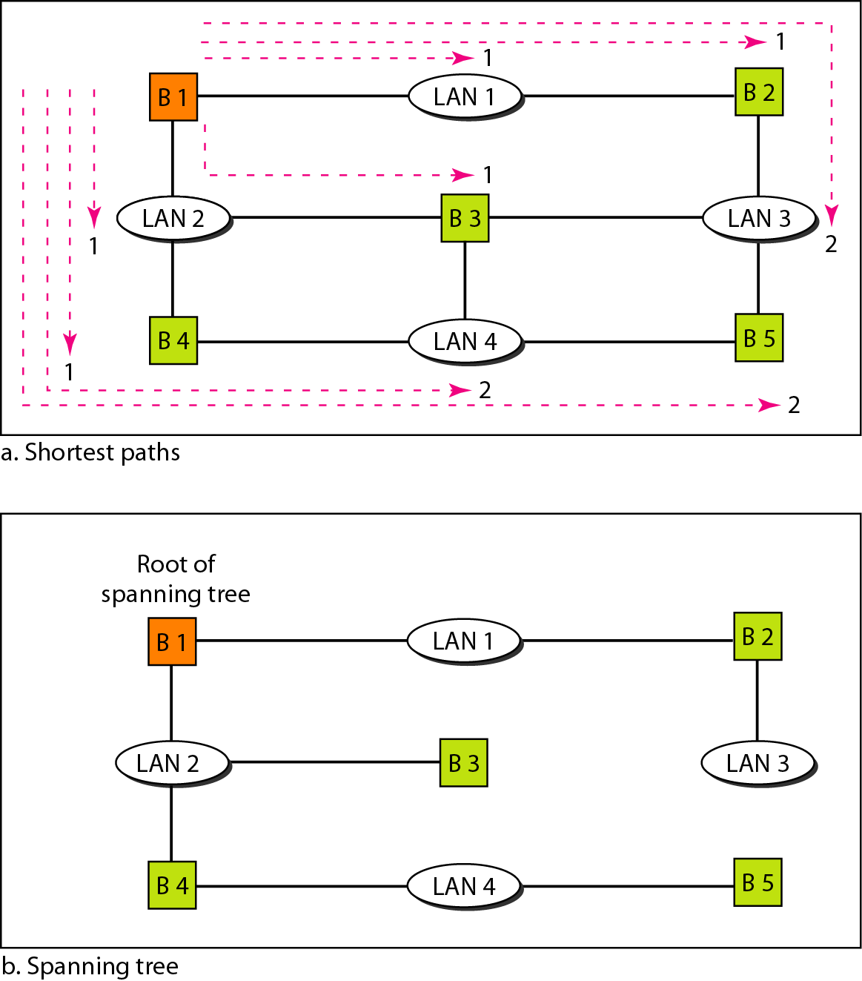

Slide 14
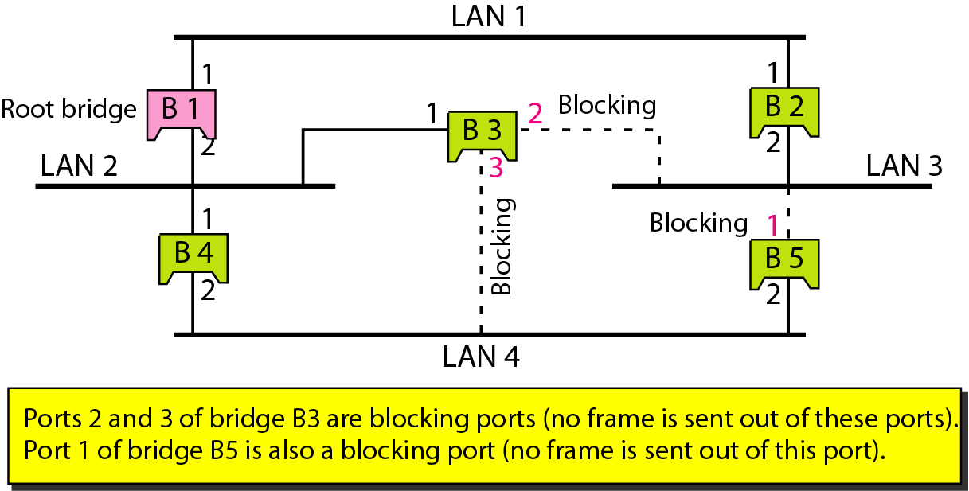

Slide 15
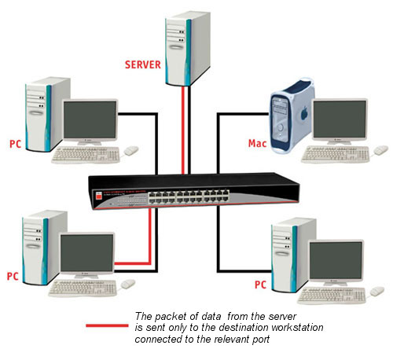
Switch
A switch is a multi-port bridge.
It stores MAC addresses in an internal lookup table.
Temporary switched paths are created between the frame’s source destination.
Some Switches have limited layer 3 IP routing capabilities.
Switches can be configured to use VLANS.
Switches support spanning tree protocol to create resilient networks.

Slide 16
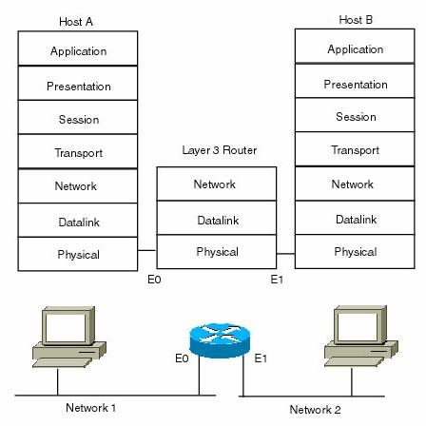
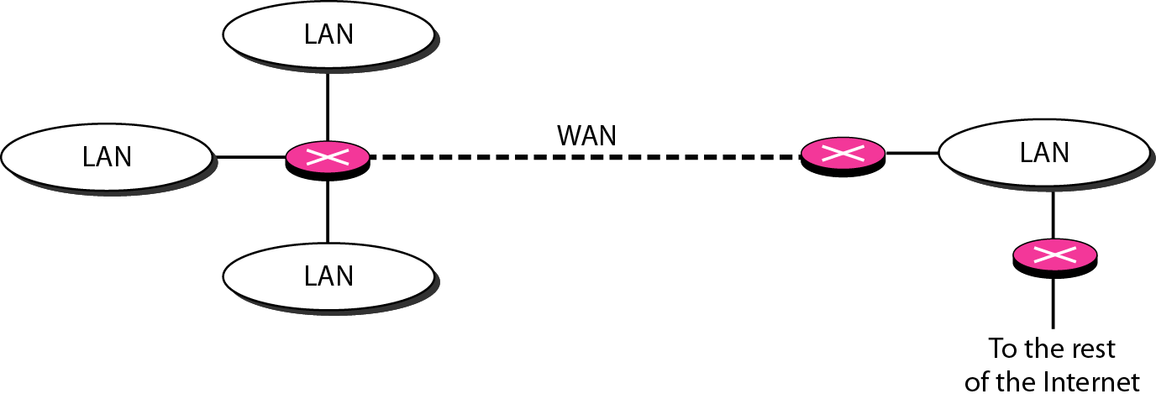
Router

Slide 17
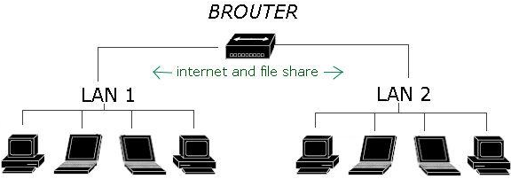
Brouter : [ Bridge+router ]
Brouter is the device which is used as both a bridge and router, It is combination of network bridge and a router.
Brouter routs some different protocols/IP and also connect them together in the form of bridge.
In short it is used as LAN and Internet source at the same time.
Using brouter we can share files to other computers connected on same brouter.

Slide 18
Hub | Switch
It is a broadcast device | It is a point to point device
It operates at physical layer | It operates at data link layer
It is not an intelligent device | It is an intelligent device
It can not be used as a repeater | It can be used as a repeater
Not very costly | costly
Router | Bridge
Network layer | Data link layer
Connect two or more network | Regeneration, check MAC address
Types: Distance vector, Link state | Transparent, Routing
Uses hardware and software | Uses tables relating the addresses and ports
Connecting networks | Connecting computers

Slide 19
Hub | Switch | Bridge
Broadcast | Point to point | Both
Physical | Data link | Both
Not intelligent | Intelligent | Highly intelligent
Simply broadcast the incoming packet | Uses switching table to find correct destination | Filtering, forwarding and blocking of frames
Low cost | Expensive | Very expensive

